Slide 1
The kinematics and dynamics of animal movement
Bimanual coordination: finger waggling and the HKB model
Interpersonal movement synchronization
Horse gait change to save energy
The dynamics of human walking and running
The control of running on irregular terrain – an example of embodied cognitive control.

Slide 2
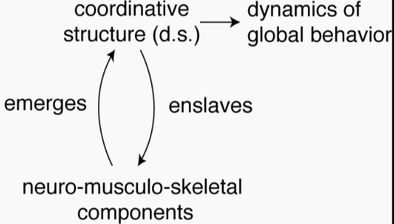
The dynamic hypothesis of synergy (coordination + control)
The action system is a self-organizing dynamical system
Treat a coordinative structure (synergy) as a low-dimensional dynamical system
Study dynamics of the resulting movement
Stable behavior = attractors
Critical behavior = bifurcation

Slide 3
Linear mass-spring

Slide 4

Coordination within and between persons
Most daily actions involve intra- and inter-person coordination.
Ramenzoni et al, 2011)

Slide 5
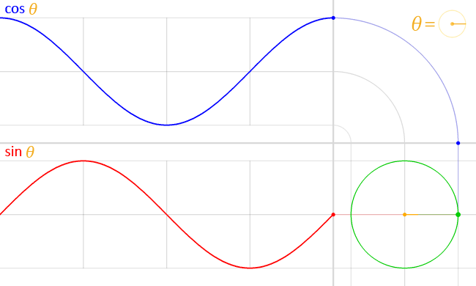
From oscillatory movement to waves
http://en.wikipedia.org/wiki/Sine

Slide 6
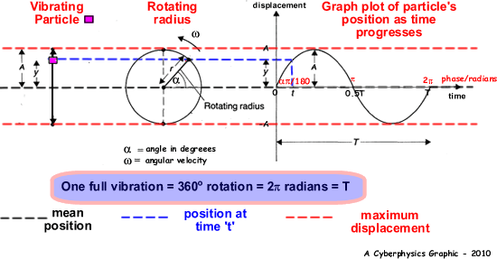
From oscillatory movement to waves

Slide 7
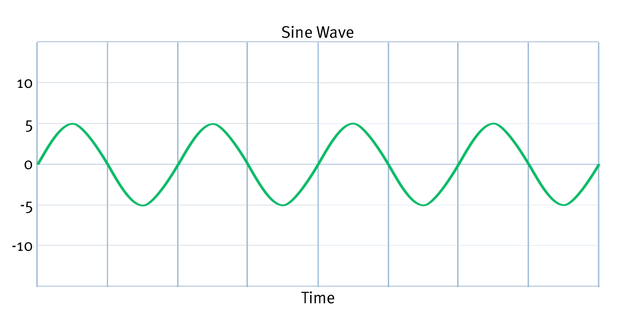
Basics of waves
f = 1/T
f: frequency
T: period
Amplitude (A)
displacement
Period (T)
Time

Slide 8
Basics of waves
f = 1/λ
f: frequency
λ: wavelength
Amplitude (A)
displacement
Wavelength (λ)
Phase
Notes:
http://en.wikipedia.org/wiki/Sine

Slide 9
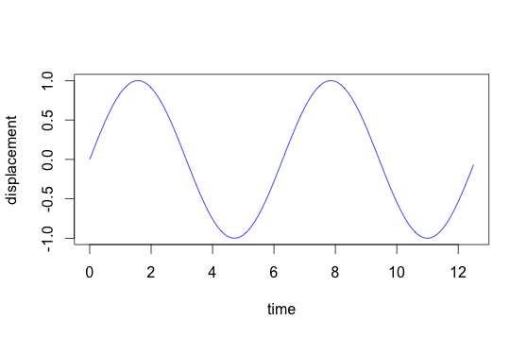
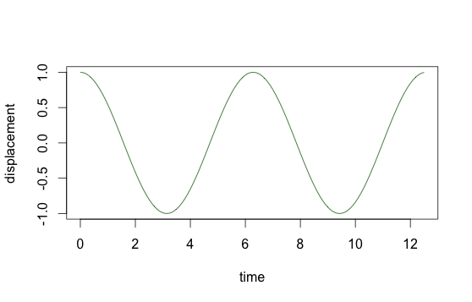
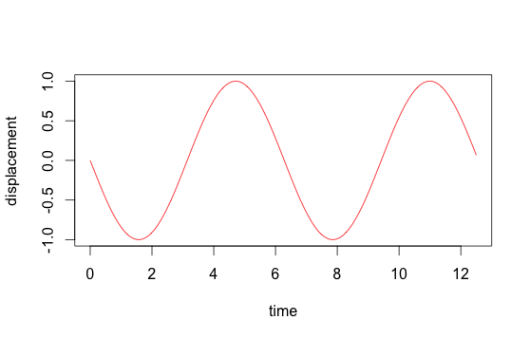
Phase difference and phase shift
Three objects rotating on a circular path (this is not a phase portrait)
y
ϕ₁
ϕ₁
ϕ₂
x
displacement
ϕ₂
ϕ: Phase difference, phase relation, phase shift
phase

Slide 10
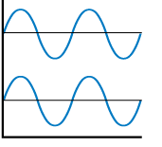
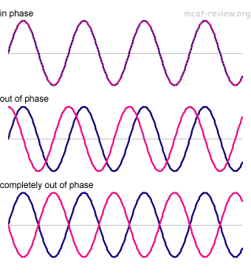
Phase relations
In phase; phase diff= 0°
Out of phase; phase diff ≠ 0°
Antiphase (a special case of out of phase);
Phase diff = 180°

Slide 11

In phase (0° phase diff) demo

Slide 12

Anti phase (180° phase diff) demo

Slide 13

Out-of-phase (90° phase diff) demo

Slide 14
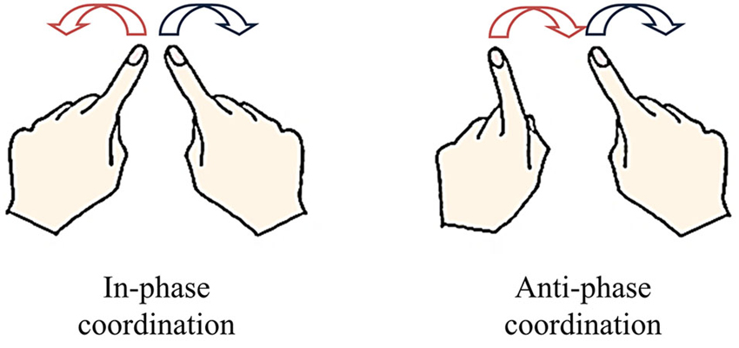
Intrapersonal coordinated rhythmic multi-limb movement: bimanual coordination
We are talking about whether the muscle movement is in- or anti-phase, not the fingers’ movement directions.

Slide 16
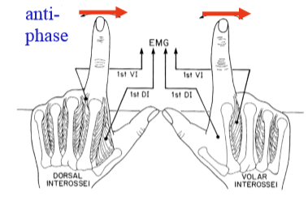
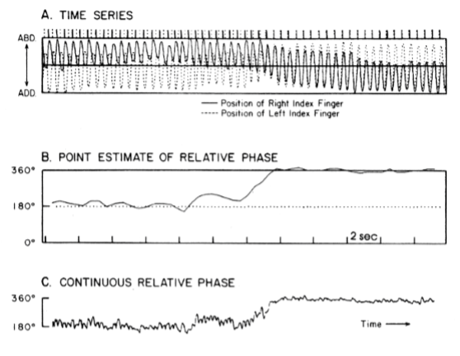
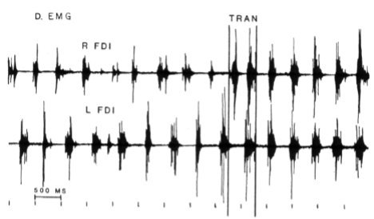
Kelso et al, 1980’s
TRAN
Increasing frequencies

Slide 17
The phenomenon: stability of coordinated rhythmic multi-limb movement
Relative phase is a measure of coordination.
Relative phase = 0°/180° → stable behavioral patterns; Relative phase ≠ 0°/180° → unstable behavioral patterns.
Stability of coordination of rhythmic limb movement: three properties
Property 1: there are only two stable modes: 0° and 180°;
Property 2: 180° is less stable than 0 °, especially at higher frequencies.
Property 3: phase tran is unidirectional:
Increasing freq 180 ° → 0 °; decreasing freq 0 °

Slide 18
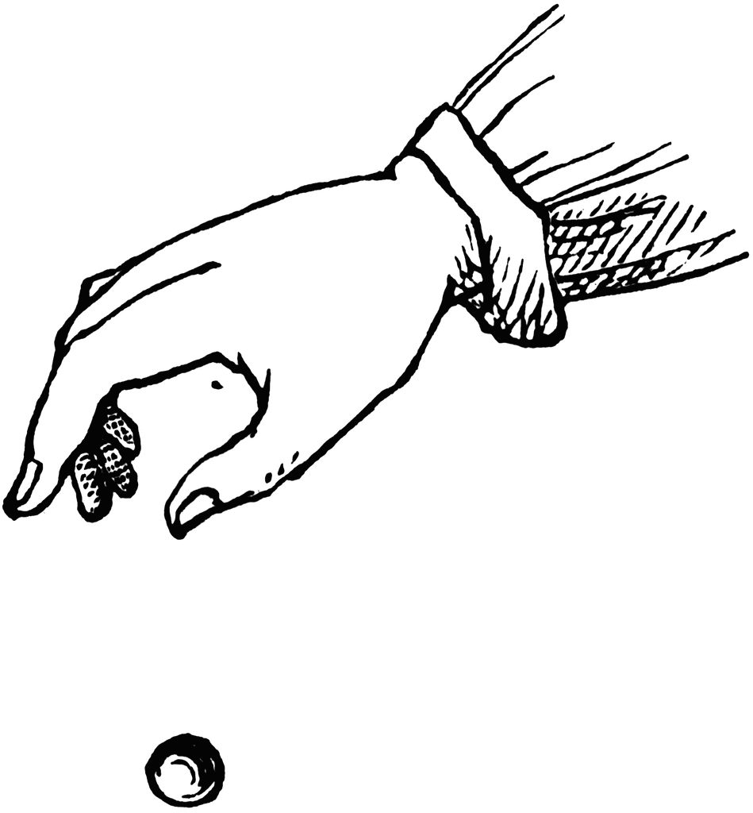

The dynamics of bimanual coordination: The HKB Model
What is a stable behavior, in terms of physics/dynamics?
A stable behavior is one that requires the least energy to produce (or the most energy to perturb).
Like the ball is not going to stay on the wall of the bowl but finally rests (0 kinetic energy) at the lowest point (minimum potential energy) of the bowl.
When the system settles, it is called the system has reached “equilibrium”. That means a lot of energy is required to perturb the system. The system is stable.
Where the ball shall finally stay is the equilibrium point of this system.

Slide 19
The dynamics of bimanual coordination: The HKB Model
The HKB model is a simple nonlinear model that describes the rhythmic movement of coordinated limbs.
Haken, Kelso and Bunz (1985) pointed out that
Relative phase, Φ, is the control variable for rhythmic limb movement.
There exist some Φ’s, at which bimanual coordination is the most stable. So, how do we find them? How do they behave?

Slide 20
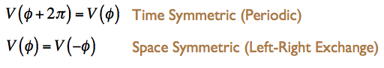
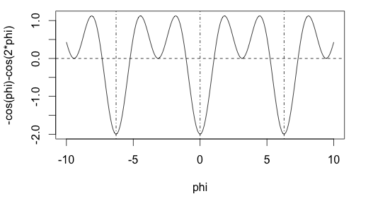
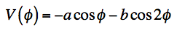
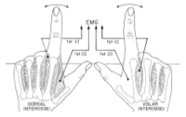
The dynamics of bimanual coordination: The HKB Model
Dynamic properties of finger waggling (cyclic oscillation):
-2*pi
2*pi
Potential function
Notes:
EMG measures potential in the muscles, the more negative the potential, the more stable the state

Slide 21
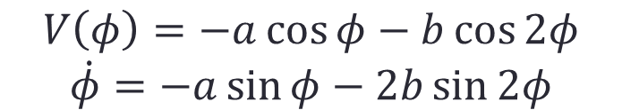
The dynamics of bimanual coordination: The HKB Model
Describing the kinematics of finger waggling:
At equilibrium (stable behavior), by definition, the change of phase difference is 0 (there is no variation of phase difference between the two fingers). Therefore,
$$V\left(φ\right)=−a\cos{φ}−b\cos{2φ}$$
$$\dot{φ}=−a\sin{φ}−2b\sin{2φ}$$
Notes:
Cos(-1)(-a/4b) is always unstable → only stable Eps are physically observable
Intro to dynamical systems: https://mathinsight.org/discrete_dynamical_system_introduction

Slide 22
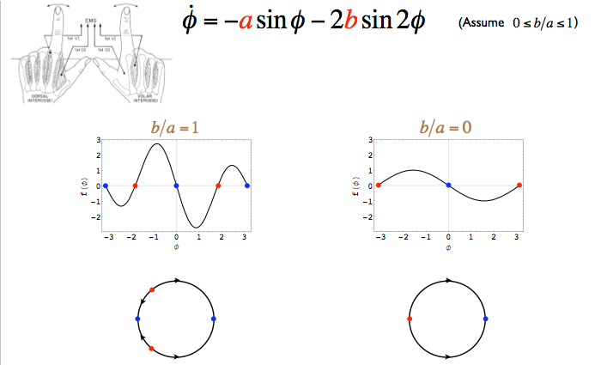
The dynamics of bimanual coordination: The HKB Model
Kinematic properties of finger waggling (cyclic oscillation):

Slide 23
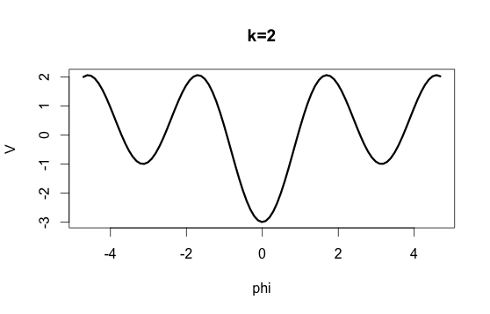
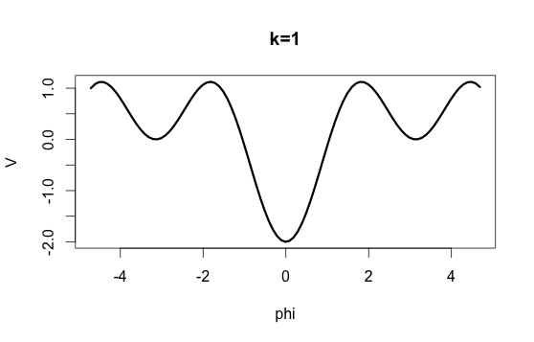
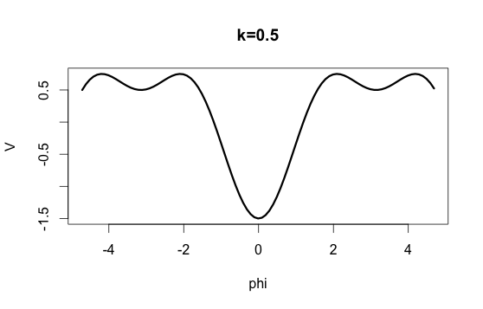
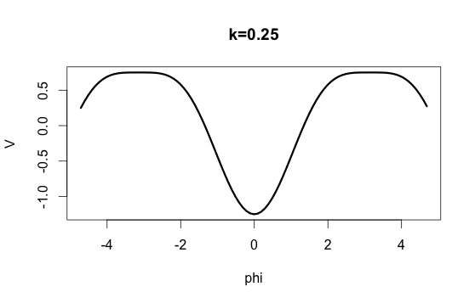
The dynamics of bimanual coordination: The HKB Model
The dynamics underlying the finger waggling pattern (the potential function):
V: potential energy
at phase difference ϕ
Frequency = 1/k

Slide 24
The dynamics of bimanual coordination: The HKB Model
The dynamics underlying the finger waggling pattern (the potential function):
V: energy
at phase difference ϕ

Slide 25
Calculate critical frequency (1/k) for system bifurcation:
A bifurcation occurs when a small smooth change made to the parameter values of a system causes a sudden 'qualitative’ change in its behavior. In this case, the parameter is k (period), the behavior change is from stable to unstable finger coordination.
Only stable EPs are observable in behaviors

Slide 26
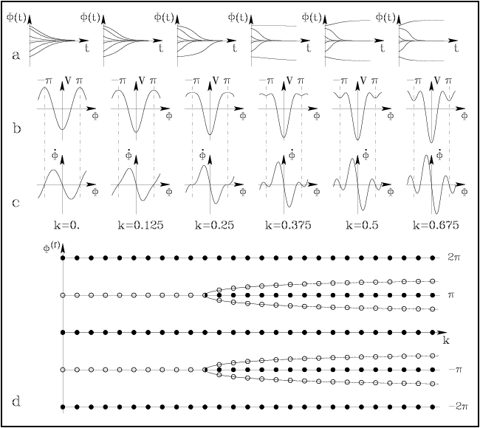
Time series
(Phase vs time)
Energy vs phase
Phase portrait
Notes:
On a phase portrait, where the curve cuts the x-axis (x-dot =0 ) is an equilibrium point. If at this point, the phase portrait has a negative slope, then this is a stable EP. If the slope at this point is positive, it is an unstable EP. Only stable EP’s are physically observable.

Slide 27
Bimanual coordination summary
The HKB model shows that a person can no longer produce coordinated antiphase finger waggling when the movement frequency exceeds 4 Hz (4 cycles per sec).
Finger oscillation frequency depends on its intrinsic dynamics (muscles, joints etc.) – coordinated dynamical system.
Phase relation (Φ) is perceived – perception plays a role in bimanual coordination.
Perceiving and producing bimanual are coupled
If you can’t perceive, say 90 phase relation, it is hard to produce it, and vice versa.
Perceiving/producing 0, and 180 phase relations is natural; perceiving/producing other phase relations can be trained.

Slide 28
Other synchrony in animal movements
The finding that (1) there are two stable phase relations and (2) 180° phase relation becomes unstable as movement frequency increases are common to many synchronized animal movements, for example:
Arm swing, leg swing, inter-personal synchrony, gait transition in quadrupeds…
Although the critical frequency for system bifurcation may differ.

Slide 29
Interpersonal coordination (synchrony)
Inter-personal synchrony is observed, but it is weaker than intrapersonal synchrony.
Why?
Coey, Varlet & Richardson, 2012

Slide 30
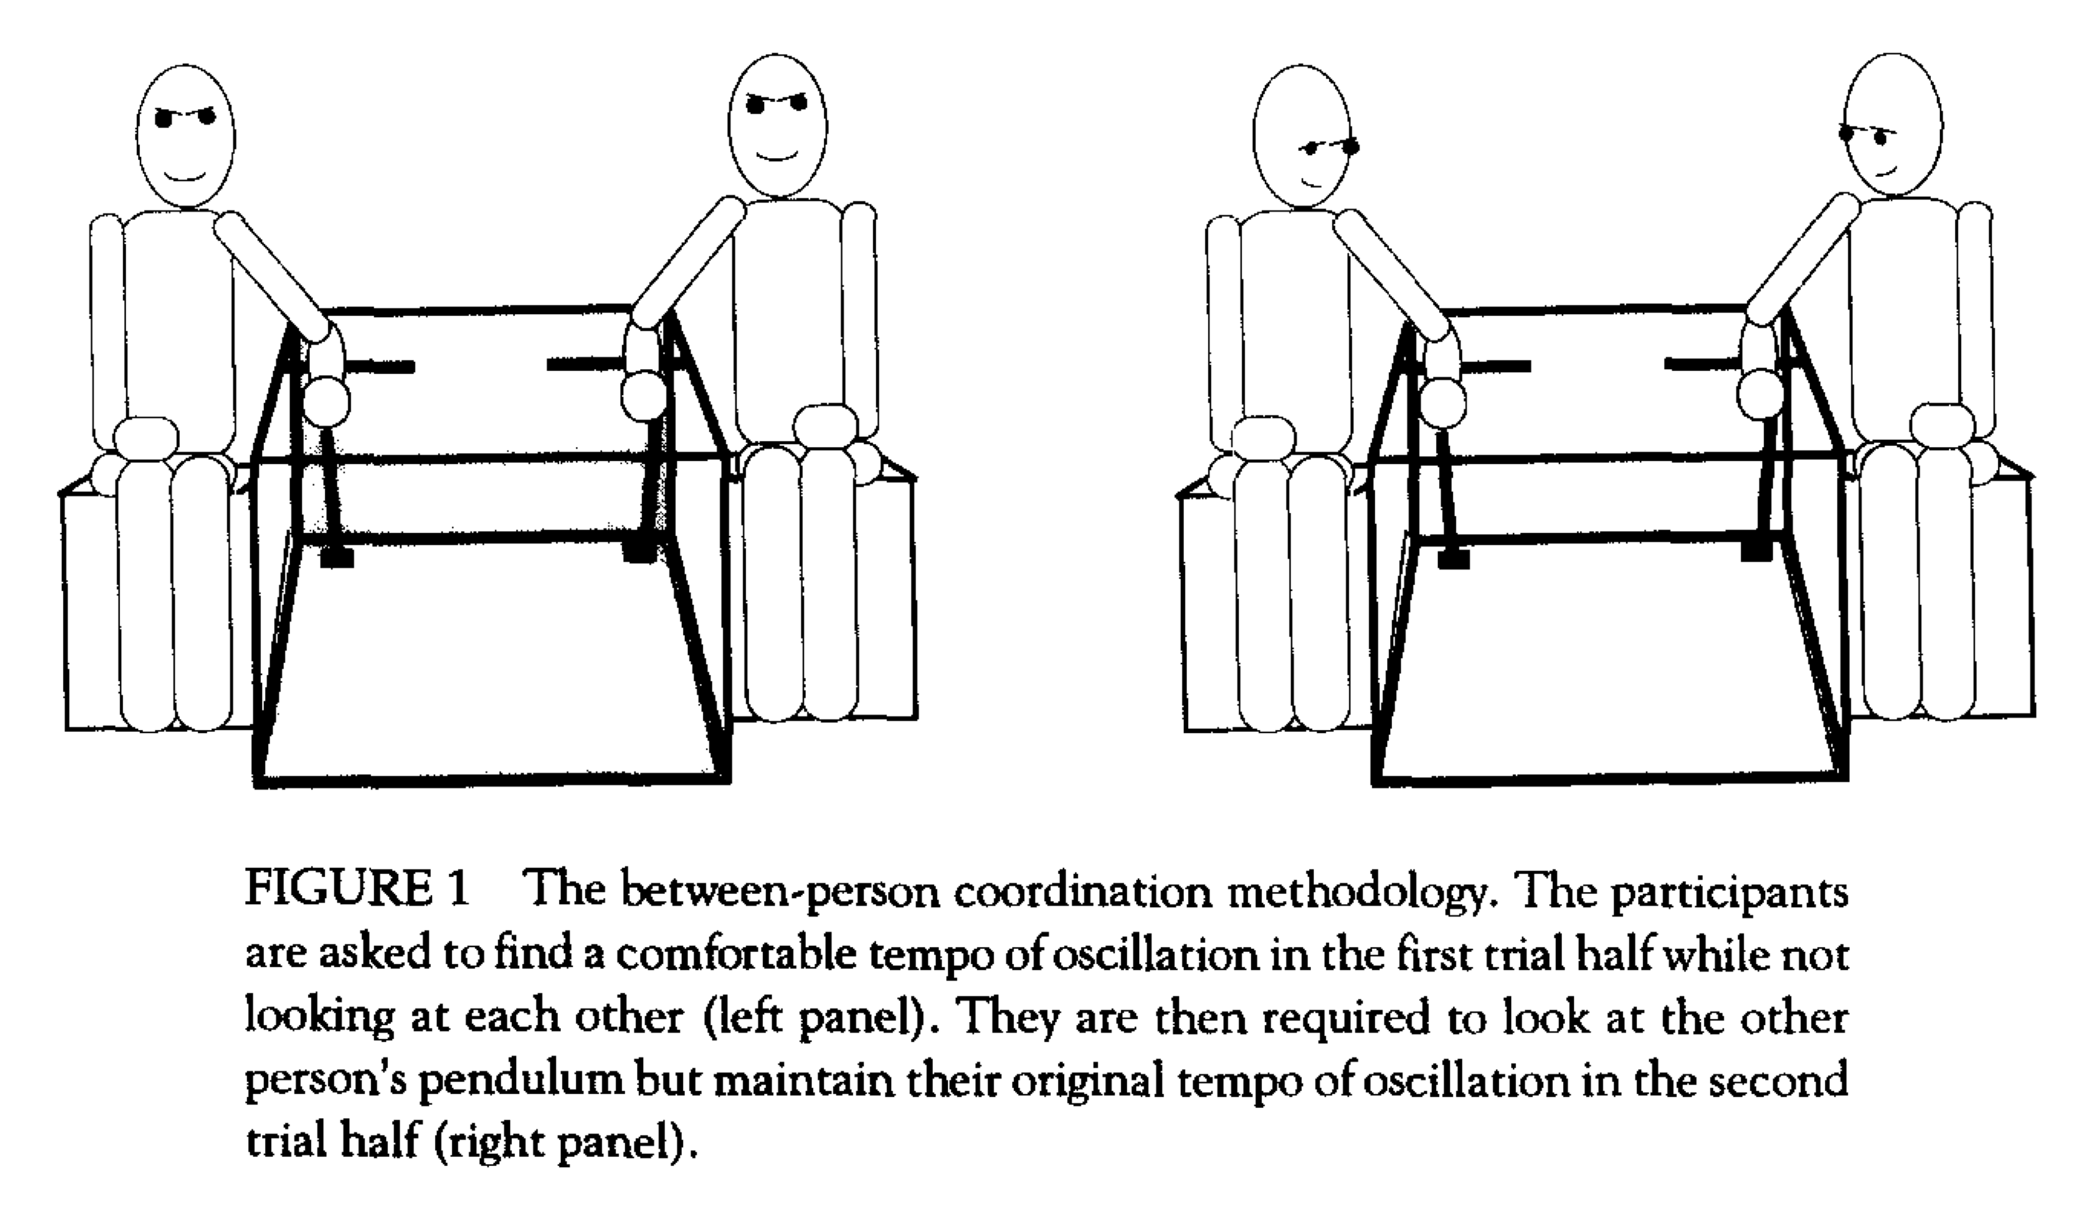
Interpersonal coordination (synchrony)
No synchrony
Synchrony at 0° and 180° phase relations.
Unintentional inter-personal synchrony existed with perception.
Schimdt and O’Brien (1997): In this experiment, S’s were told not to be disturbed by what the other person were doing and they should just focus on their own swing.

Slide 31
Interpersonal coordination (synchrony)
Temporal synchronization occurs spontaneously with or without intention.
Visual coupling is required – must look at each other.
Interpersonal coordination has a perceptual basis.
Synchronization is important in cooperation

Slide 32
Summary
Intraperson coordination
Coordination – the HKB model
Single parameter that controls bimanual coordination – the movement frequency
A taste of dynamics
Interpersonal coordination

Slide 33
Reading
HKB model on Scholarpedia
Optional -- Bingham: Phase perception and phase driven oscillators

